Slide 1
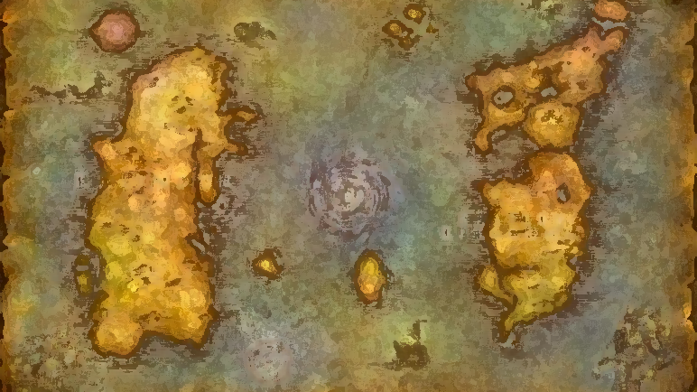
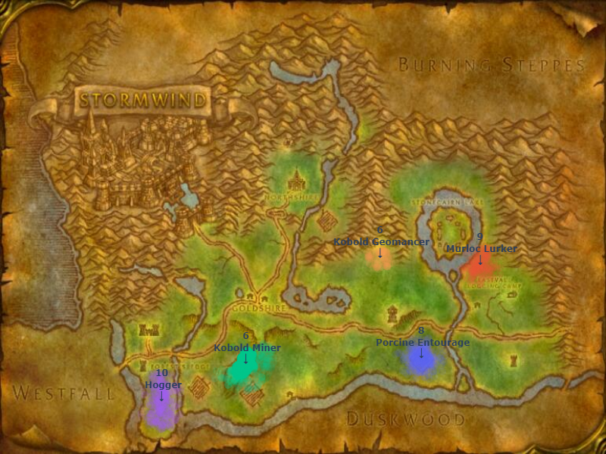
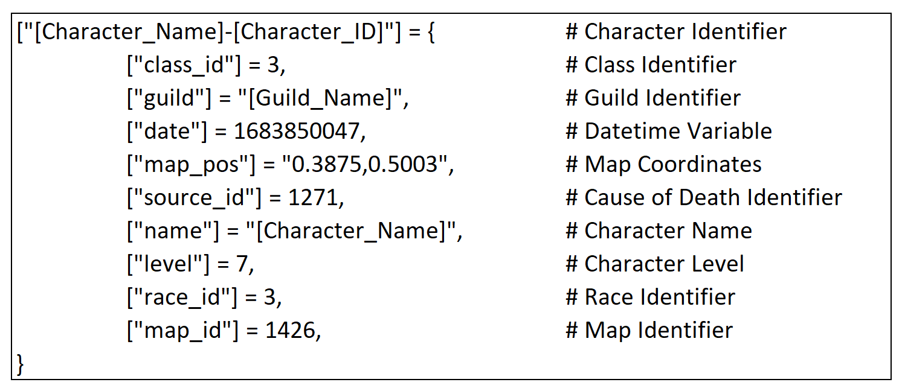
Live to Win!: Analyzing Common Causes of Death within the World of Warcraft Hardcore Challenge
Aaron Evans, Andrew Daulton, Zhentao Wang
Problem Statement
Analysis
World of Warcraft’s (WoW’s) Hardcore Challenge introduces an intense twist – character death means permanent deletion. Our research aims to uncover the key factors driving player mortality, offering crucial insights for those navigating Azeroth's perilous landscape.
We categorize and map clusters of character deaths within each zone. This enables us to identify prominent hotspots of player mortality, unveiling zone-specific hazards and shedding light on the diverse array of threats adventurers face as they traverse Azeroth's perilous realms.
Approach
We apply clustering techniques on character death records to identify patterns in character mortality across distinct leveling zones. This method combines game data with spatial analysis to reveal key challenges that define the Hardcore Challenge experience.
Data
We use character death records gathered by members of the WoW community and aggregated by one of the Hardcore WoW addon developers.
Findings
1. Our analysis uncovers 190 clusters across each zone leveling zone.
2. We clearly categorize approximately 2/3 of all clusters by cause of death.
3. We propose overarching advice to assist players undertaking the Hardcore Challenge and offer targeted advice at a regional level.

